Slide 1
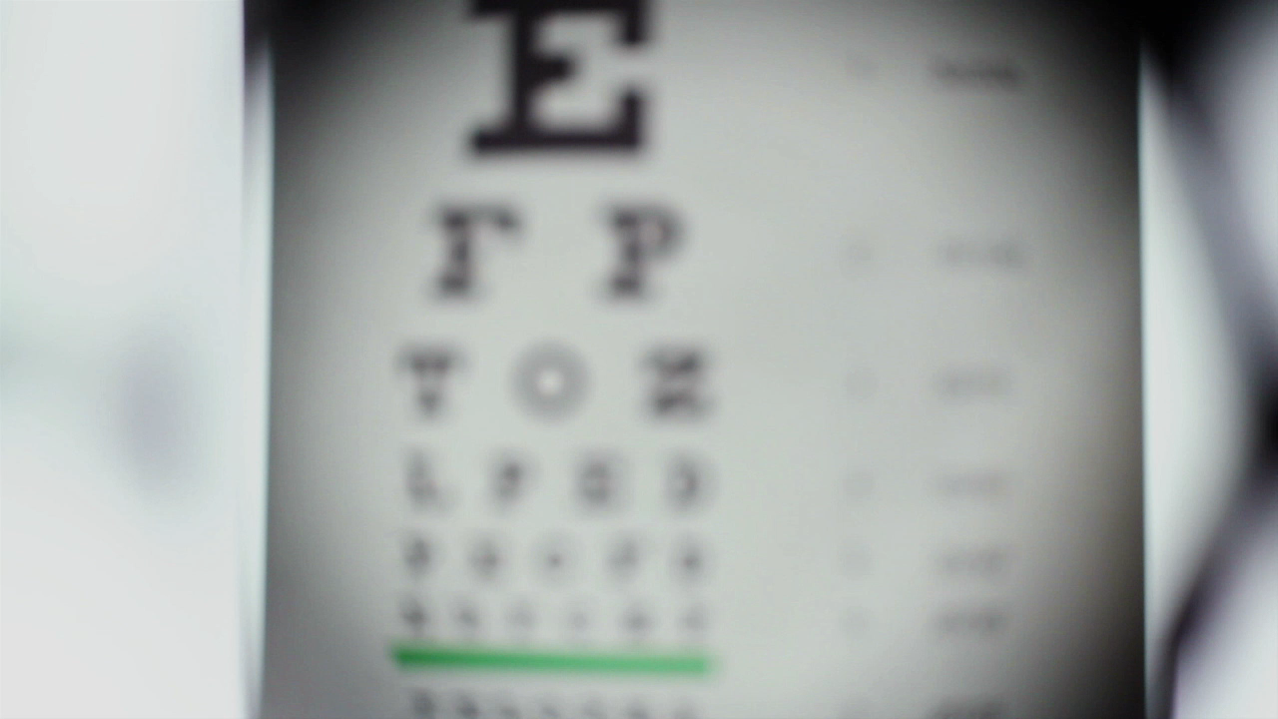
Smart System for Visually Impaired People

Slide 2

Presented By 1 - Mohamed Nasser Mohamed Khodary 2 - Mohamed Ahmed Hassan 3 - Mohamed Atta Ahmed 4 - Mahmoud Mohamed Nagi 5 - Ziad Abdelmohsen Mohamed 6 - Tamer Khaled Ali 7 - Yasser Ramdan
Supervisors
DR. Nag
Dr. Esraa

Slide 3
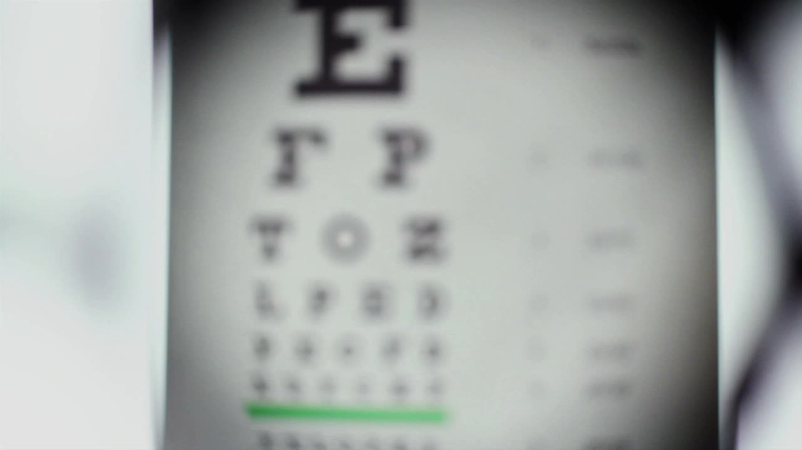
Project Overview
Introduction
The Aim of Project
Explanation
Smart Glasses for the Visually Impaired People
Wearable Smart System

Slide 4
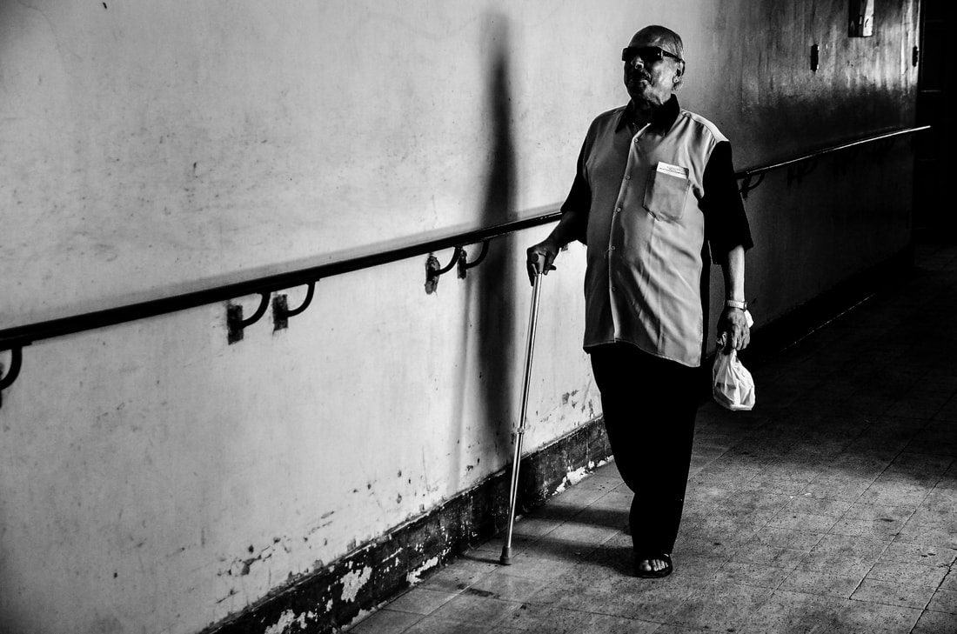
Introduction
At least 800,000 Egyptians are blind and 3 million visually impaired.
These people need some help to make their life easier and better.
We propose a system with several features to provide VIPs with a means for safe and independent mobility and continuous contact with their families.

Slide 5

The Aim of Project
This project is mainly focusing on people with visual impairments.

Slide 6
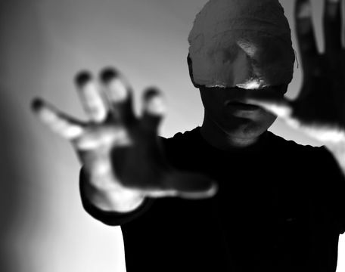
Explanation of Project
This project consists of two parts. It presents a concept for smart glasses and a wearable system to provide assistance in multiple tasks.

Slide 7
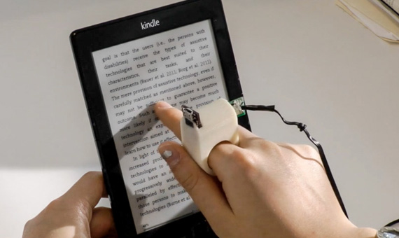
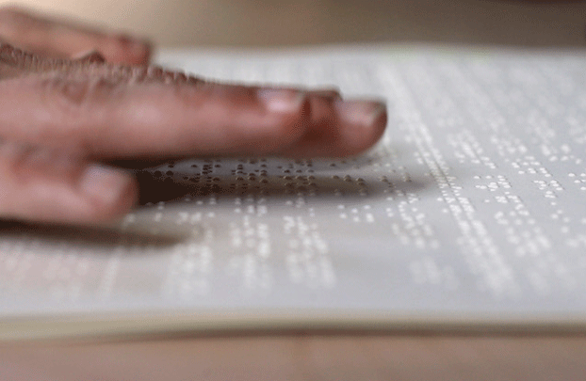
Previous Work
RING TO READ TEXT
Braille

Slide 8
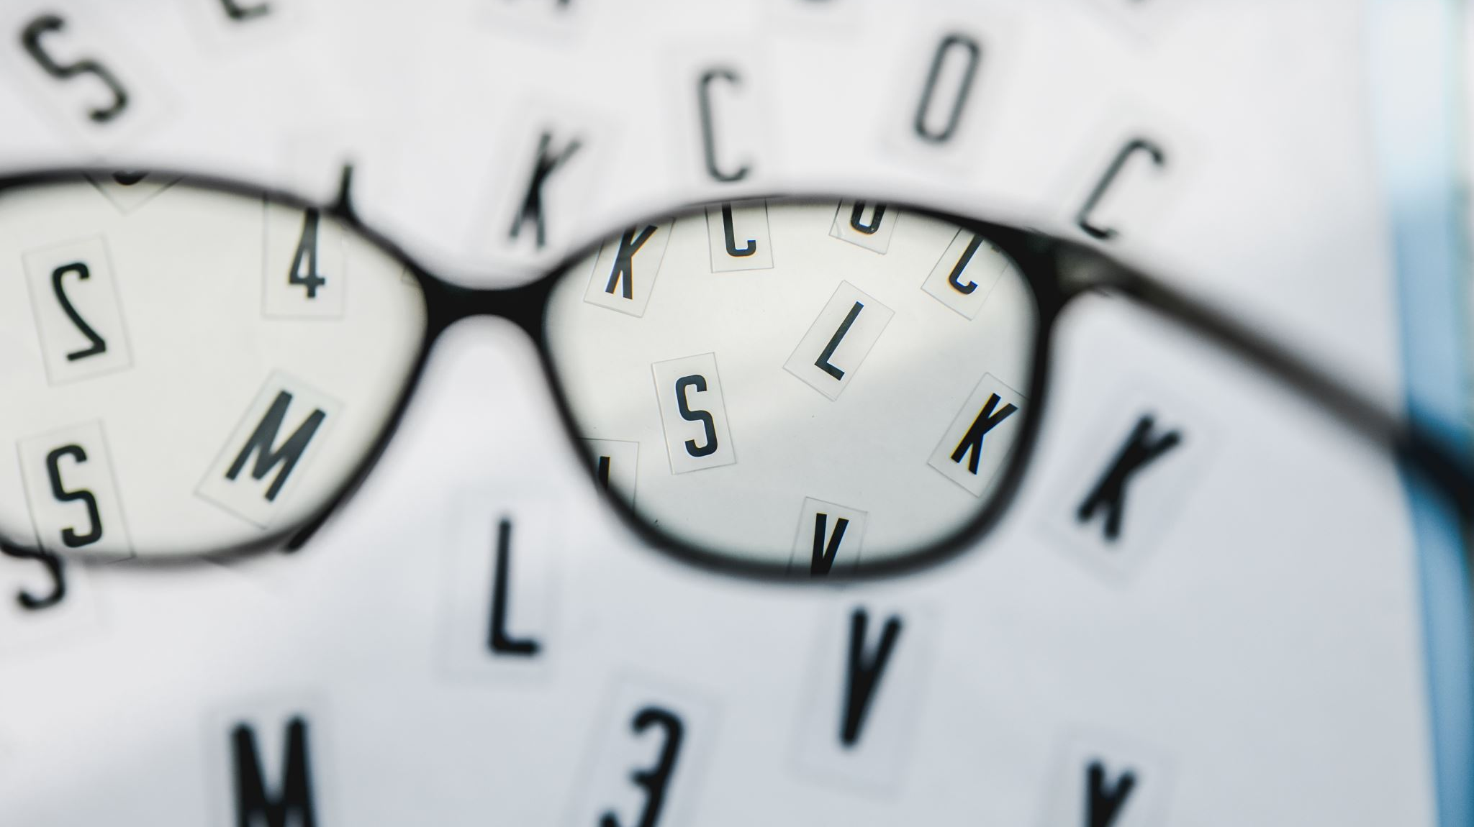
First Part (Smart Glasses)

Slide 9
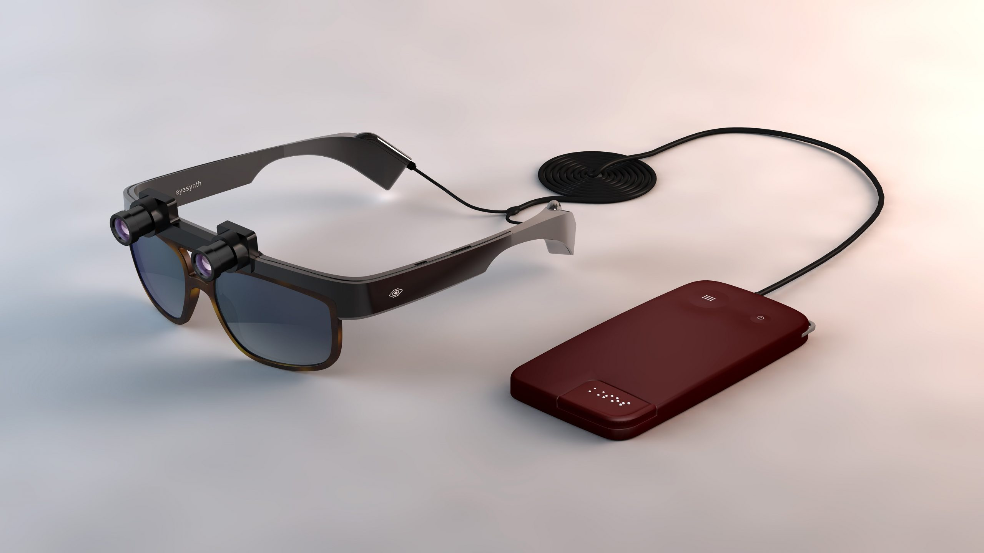
What is Smart Glasses…?
“Smart Glasses” are designed to help the blind people to read and translate the typed text which is written in the English language.
Glasses can recognize images and determine each object in the images.

Slide 10
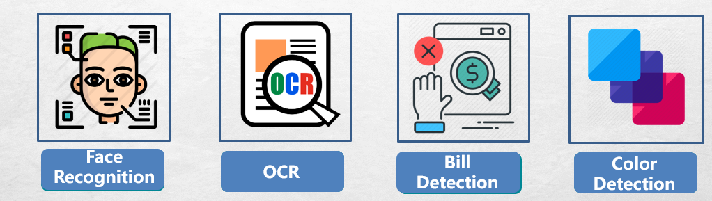

Smart Glasses Features :
Currency
Object

Slide 11
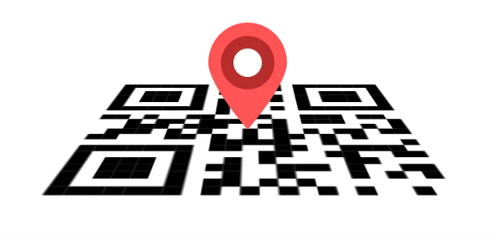
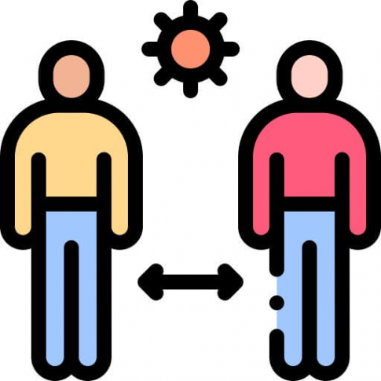
location
Smart Glasses Features :
lockation
Distances

Slide 12
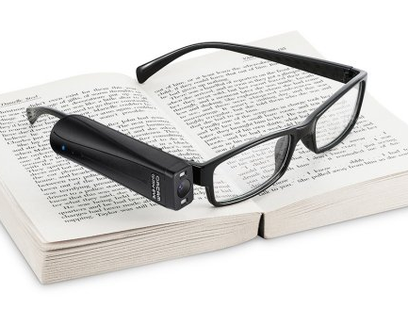
Smart Glasses for the Visually Impaired People
Components
Comparison
Block Diagram
OCR Explain
Object detection Explain
Face recognition Explain
Currency detection Explain
Code language used
Lockation Explain
Distances detection Explain

Slide 13

Components

Slide 14

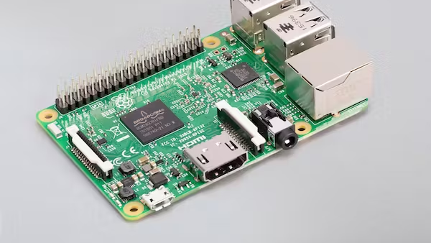
Raspberry pi 4 model B

Slide 15
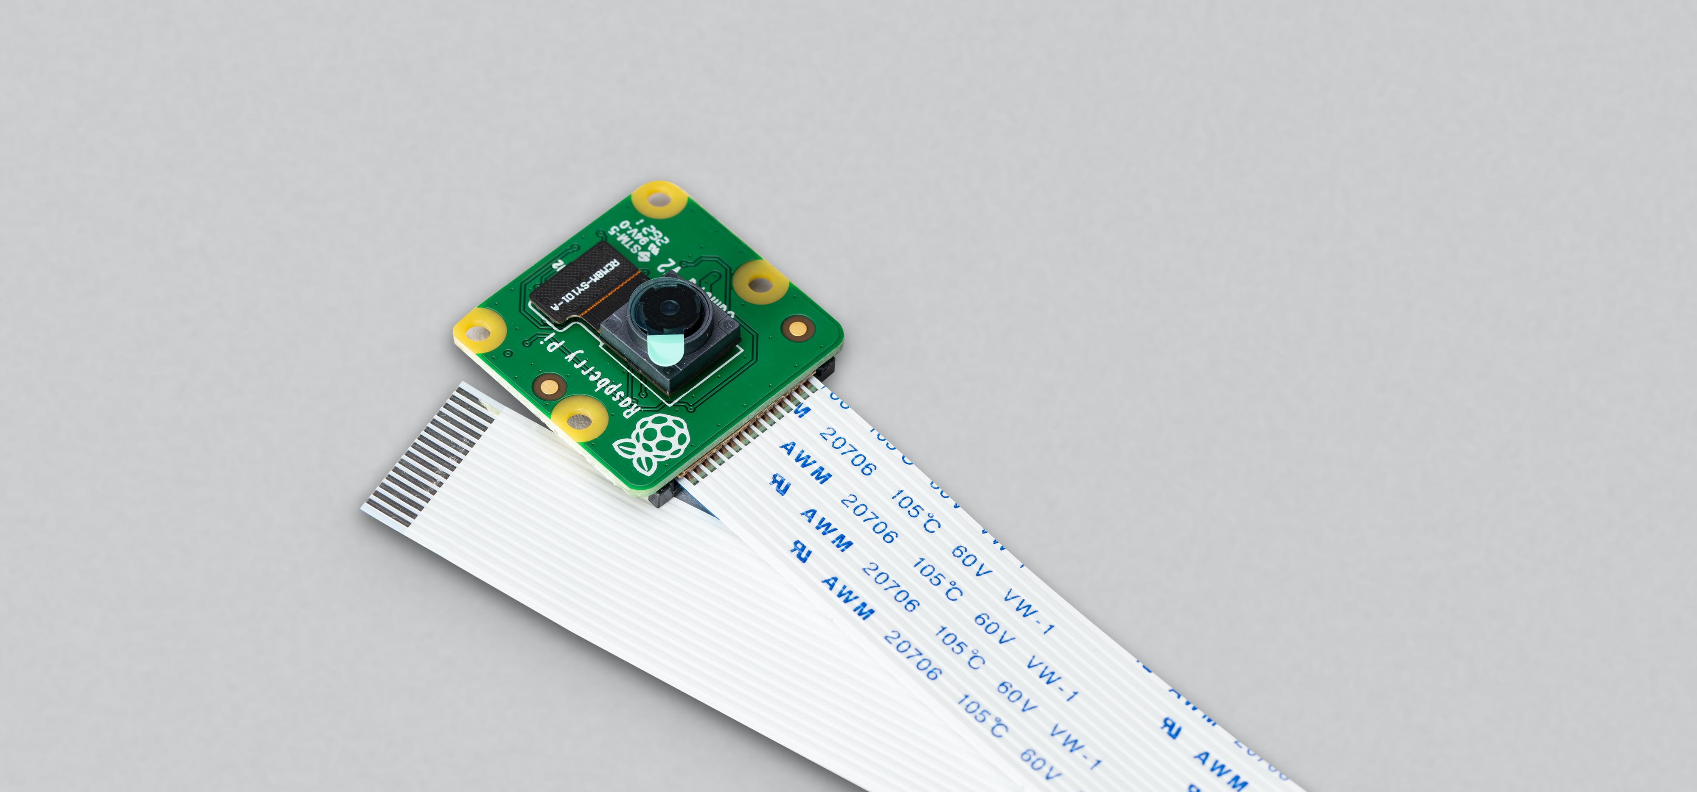
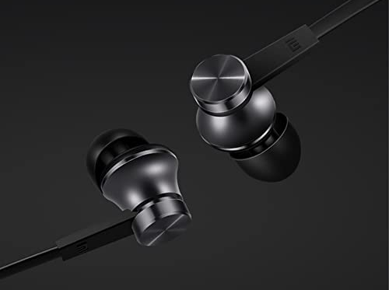
COMMUNICATION
Raspberry pi Camera V2
Headphones

Slide 16
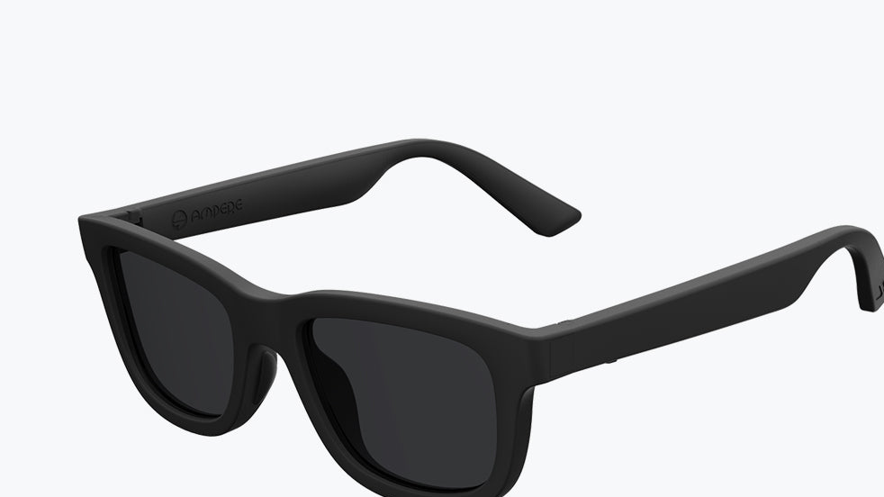
Other Components
Buttons
Wires
SD Card
Glasses
Battery

Slide 17
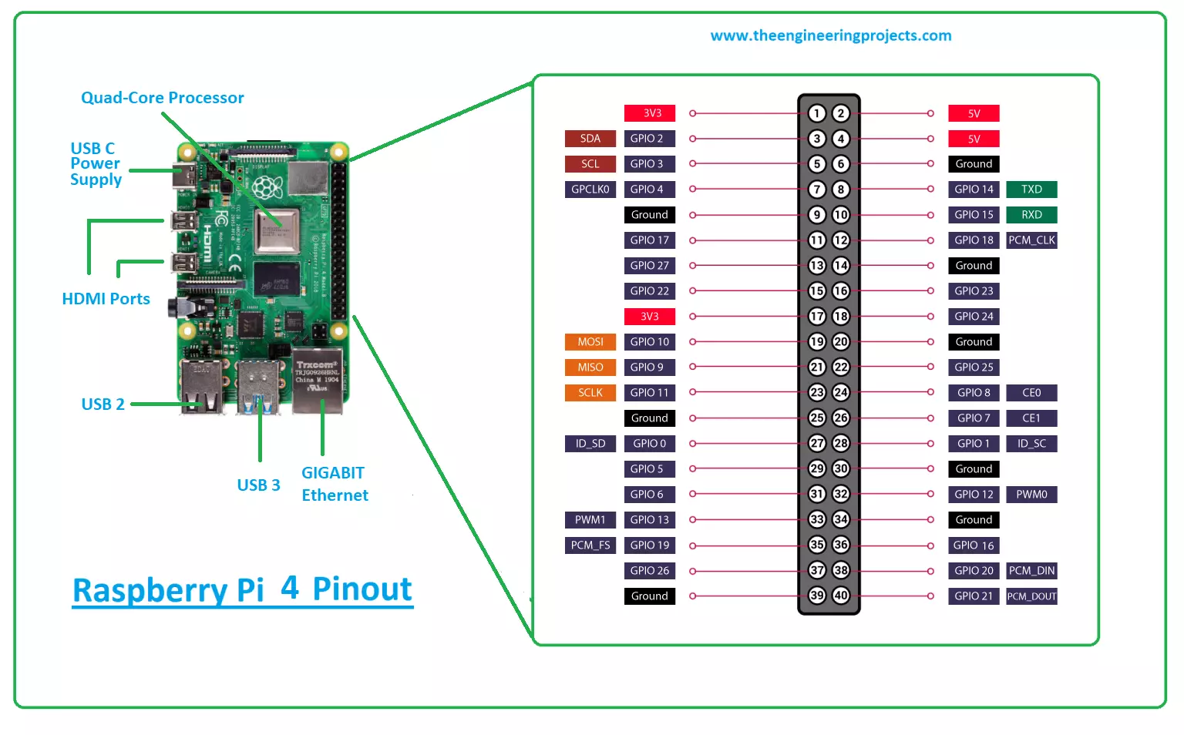
CONTROLLER
Raspberry pi 4 model B

Slide 18
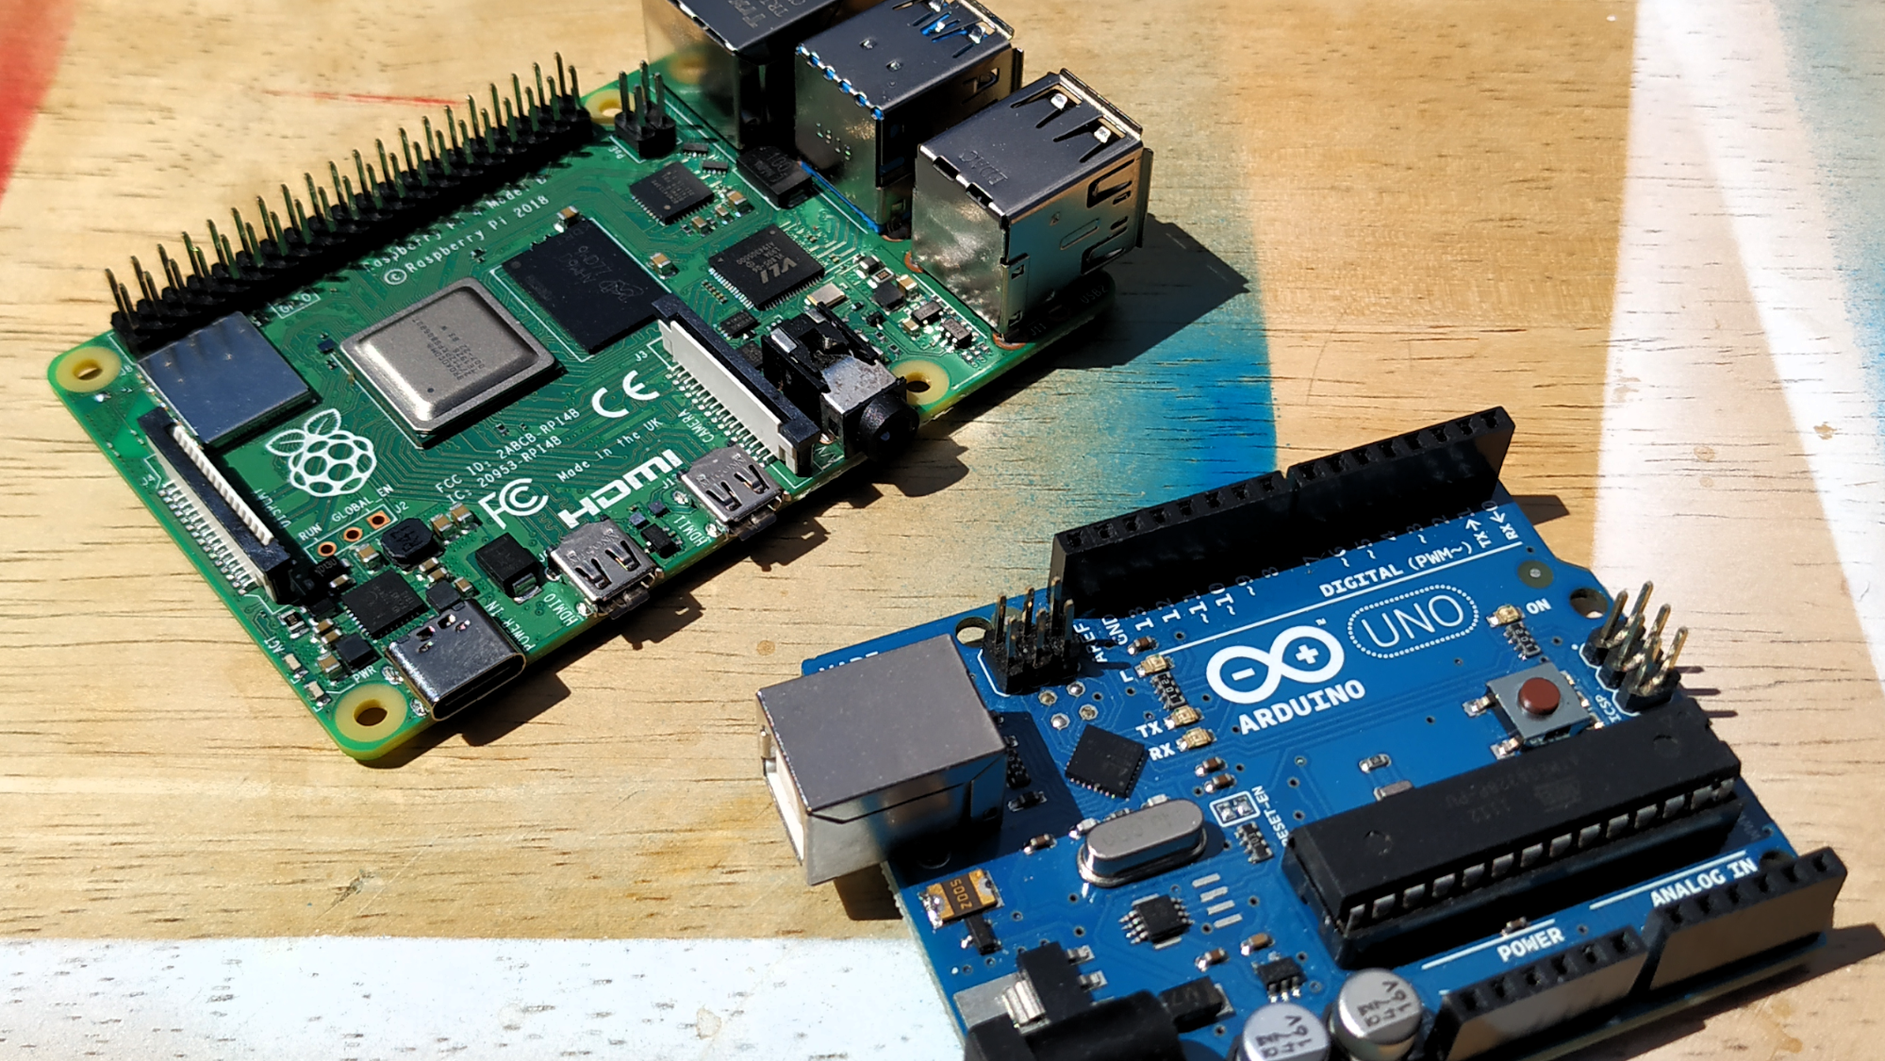
Why Raspberry pi 4b

Slide 19
Specs | Arduino UNO | Raspberry Pi 4B
OS | None | Win10 Or Linux
Speed | 16Mhz | 1.2Ghz
Ram | 2KB | 2GB
Disk | 32KB | Depends on SD card
GPIO Pins | 14 Digital pins | 40 Digital pins
Connectivity | None | USB , Ethernet, HDMI , audio

Slide 20
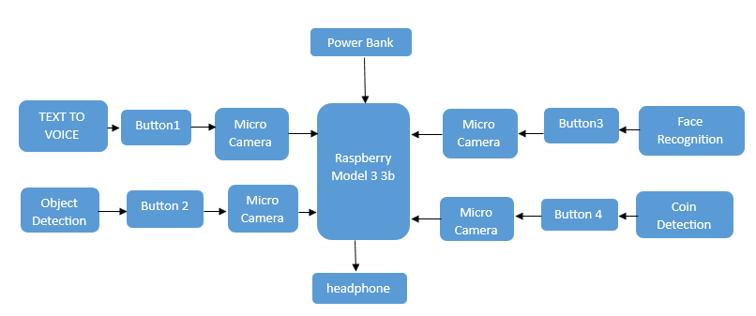
Block Diagram

Slide 21
Project Plan OF glasses
1st Scenario
1-Press Button1
2-Capture image
3-Converting the text result into Voice
2ndScenario
1-Press Button2
2-Capture image
3-Perform object detection
3rd Scenario
2-Capture image
3-Perform Face Recognition
4th Scenario
1-Press Button4
2-Capture image
3-Perform coin detection
1-Press Button3

Slide 22
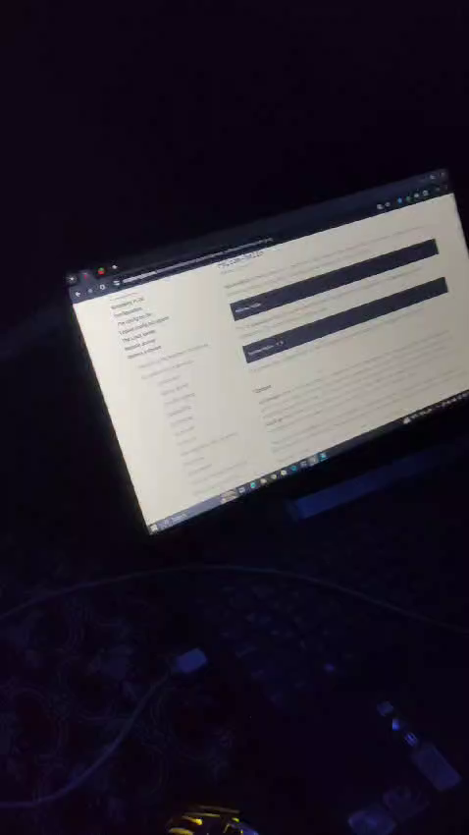

Slide 23

OCR
General Overview :
Optical character recognition is the conversion of images of typed, handwritten or printed text into machine-encoded text, whether from a scanned document, a photo of a document.

Slide 24

How Does OCR Work ?

Slide 25

Our project aims to detect the object with the goal of achieving high accuracy with a real-time performance.
Object Detection
In this project, we use a completely deep learning based approach to solve the problem of object detection.

Slide 26
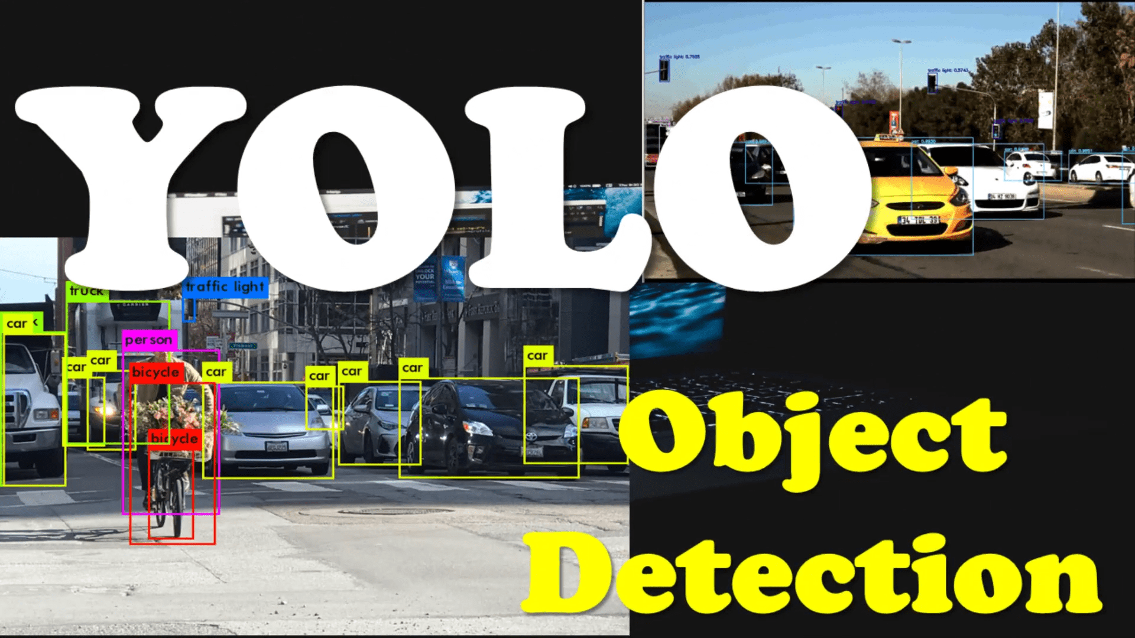
yolo v3 Algorithm

Slide 27
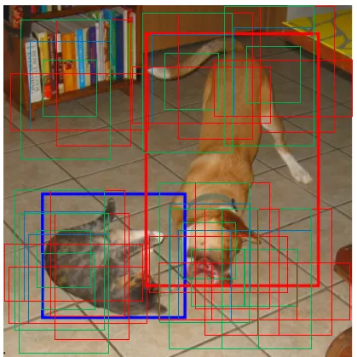
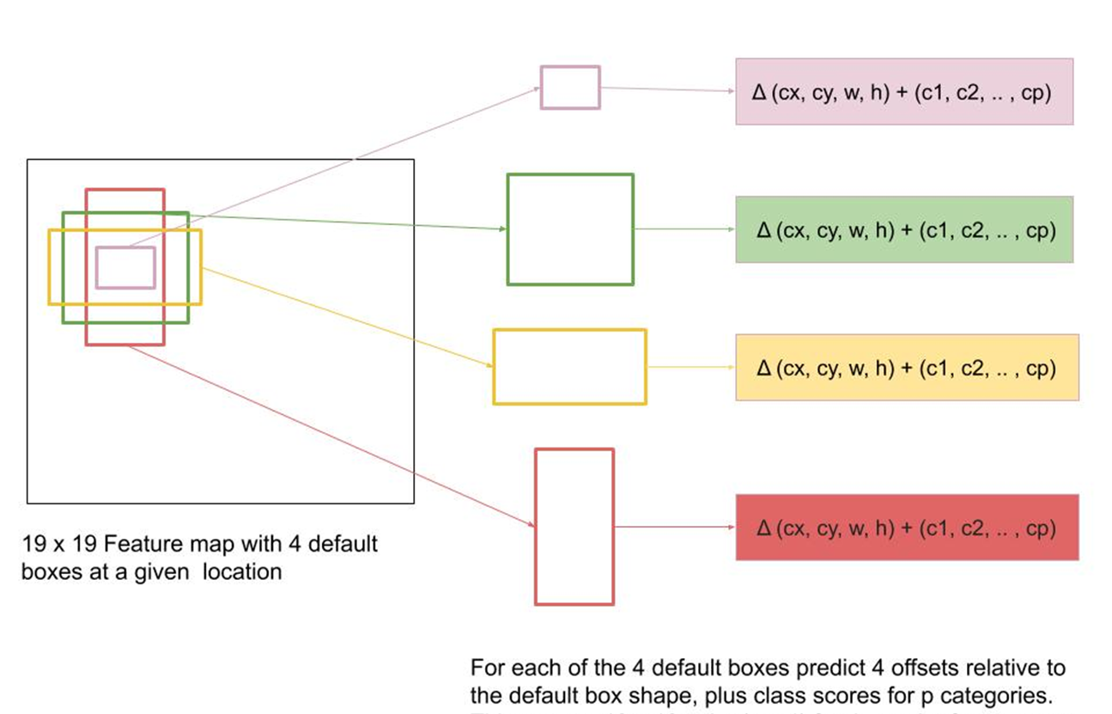
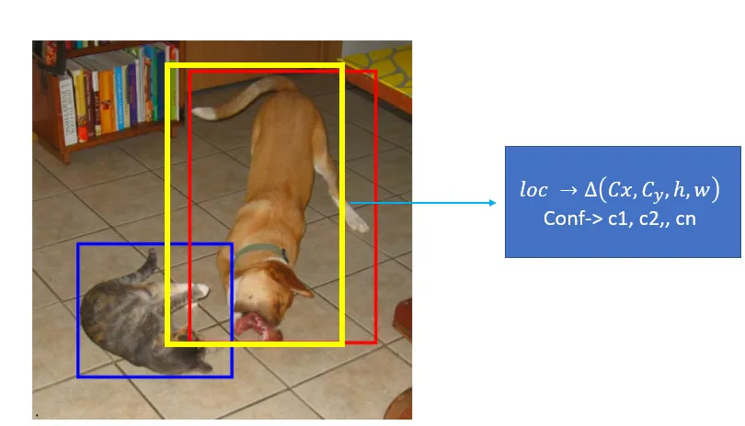
Anchor Boxes

Slide 28
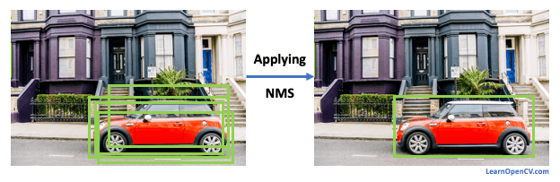
NMS (Non Maximum Suppression)

Slide 29
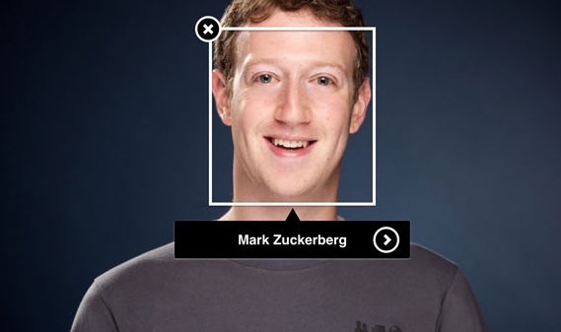
Face Recognition
General Overview
A technology capable of identifying or verifying a person from a digital image or a video frame
It works by comparing selected facial features from given image with faces within a database.

Slide 30
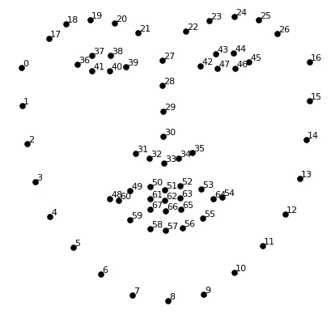
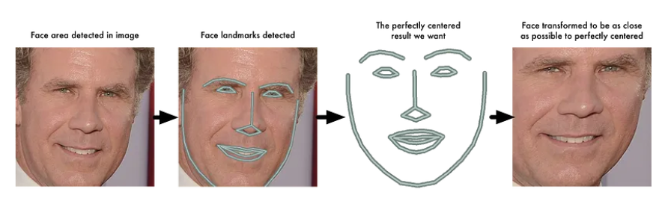
Face Landmark Estimation Algorithm

Slide 31
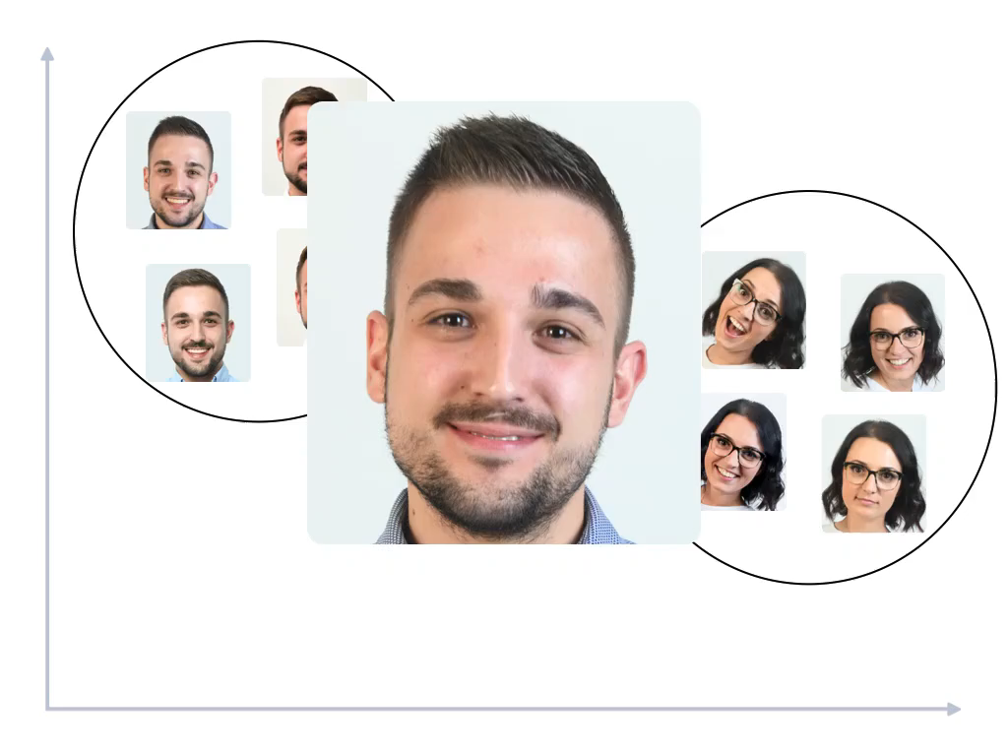
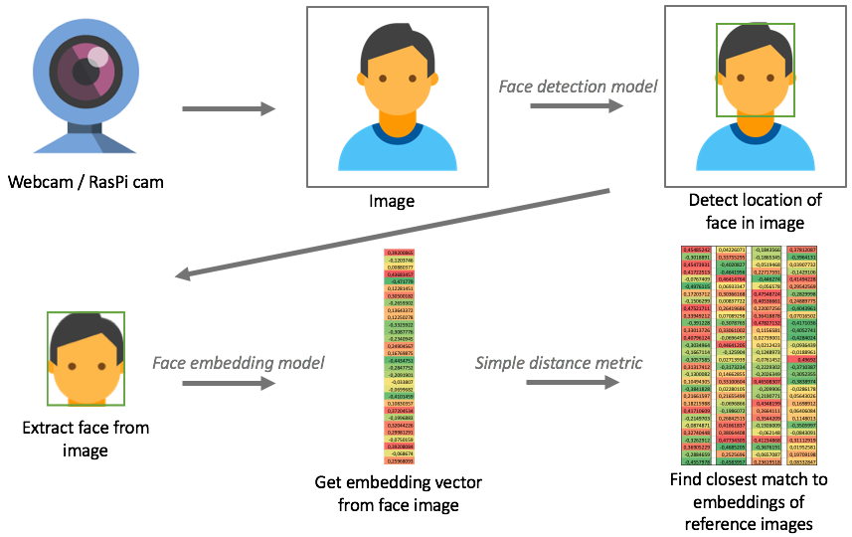
How Face Recognition Work..?

Slide 32
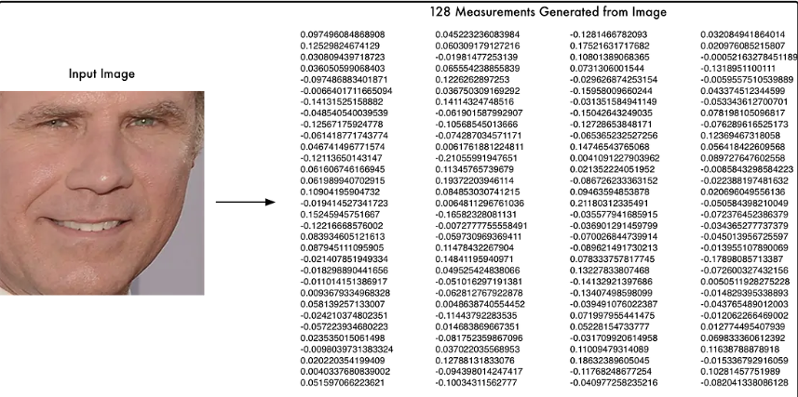
128 measurements (embedding)

Slide 33
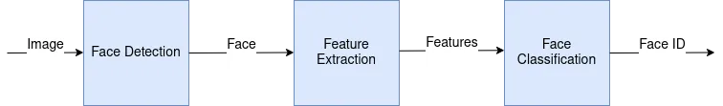
Phases of Face Recognition

Slide 34
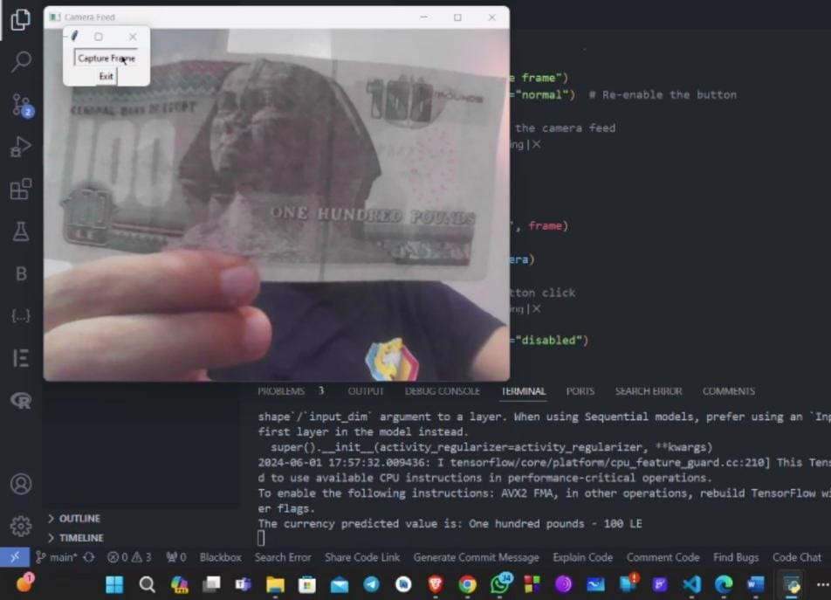
Currency detection
General Overview
refers to the automated process of identifying and classifying different types of currencies, such as banknotes.
It uses various techniques such as image processing, feature extraction, pattern recognition, and authentication to accurately identify and classify the currency.

Slide 35
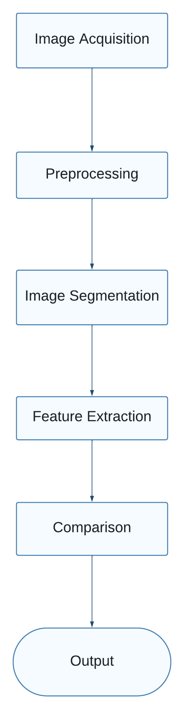
How currency detection work ..?

Slide 36
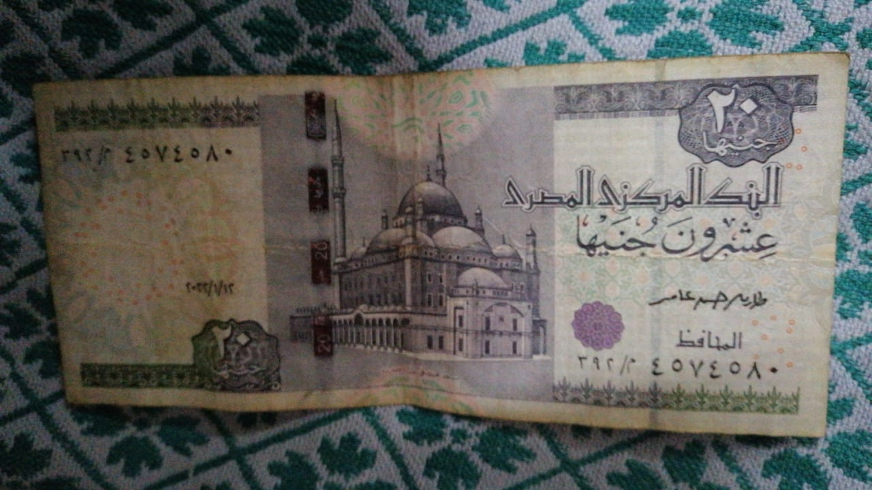

1-Image Acquisition
Image Acquisition: The first step is to acquire an image of the banknote. This can be done using different devices, such as scanners, cameras, or specialized currency recognition machines.
2-Preprocessing
Improving the quality of the acquired image

Slide 37

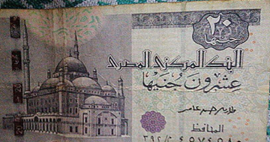
3-Segmentation
Partitioning an image into its main components:
extracting the currency paper from the rest of
the original image.
4-Feature extraction
Encoding the image contents in a brief and descriptive way.

Slide 38
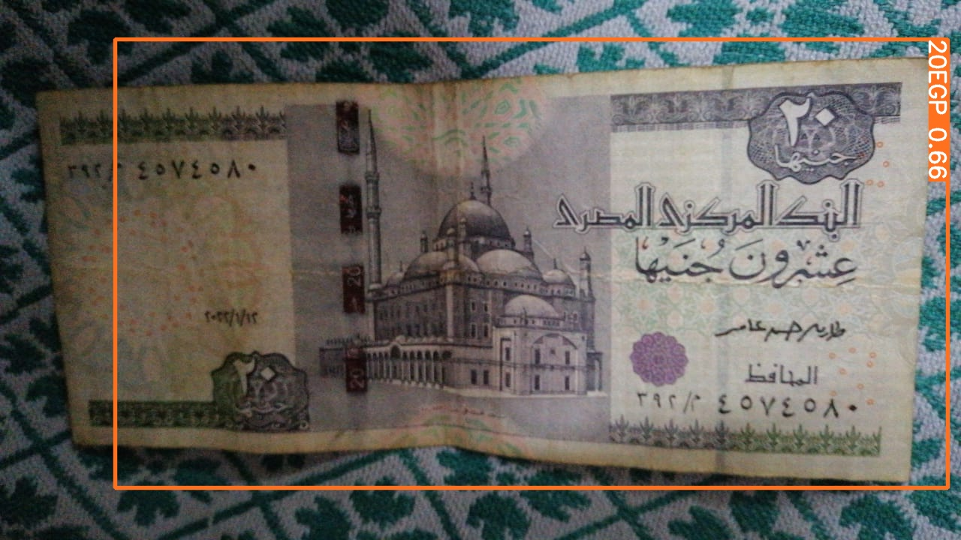
5-Classification
Classification: After feature extraction, a classification algorithm is applied to identify the currency. can be trained on a dataset of labeled currency images to learn the patterns and characteristics of different currencies.
6-Output
Cost of currency

Slide 39
GSM Chip
A GSM (Global System for Mobile Communications) chip is a semiconductor device
That provides the functionality required for a mobile phone to connect to a GSM network.
TheGSM chip is responsible for communication between the mobile phone and the network,including voice and data transmission

Slide 40
The GSM chip supports various frequency bands,
depending on the region and the mobile network,
and can operate on different transmission technologies,
including 2G, 3G, and 4G/LTE.
The chip also supports various communication protocols,
GSM chips are widely used in mobile phones, smartphones, and other wireless devices, such as modems and routers, that require mobile network connectivity.
The chips are also used in various applications.

Slide 41
SIM 900A GSM Module
The SIM900A GSM module is a compact and low-power GSM/GPRS (General Packet Radio Service) module that is designed to provide mobile network connectivity to a wide range of applications.
The module is based on the SIM900A chipset and supports the 900/1800 MHz frequency bands
The module can be connected to a microcontroller or single-board computer using a UART interface and supports various communication protocols, including TCP/IP, HTTP, and FTP.

Slide 42
SIM 900A GSM Module with AVR Microcontroller
the communication with this module is done through UART or RS232 Interface. The data is sent to the module or received from the module through UART interface.
The module is typically connected to 4.0V standard power supply.
The ground of controller and module must be connected for voltage reference.

Slide 43
a working GSM SIM card to the module. On powering the module, the NETLIGHT
LED will blink periodically to state successful connection.
After all connections are done,we need to write a program for the microcontroller to exchange data with module.
Since data exchange sequence between controller and module is really complex we will use libraries prewritten for the module.
You can download libraries for controller or module through their websites.
Using these libraries makes the communication easy.
All you need to do is download these libraries and call them in programs.
The controllernsends the data to the module through UART Interface based on protocol setup in libraries.
The module sends this data to another GSM user using cellular network.
This way we can use GSM900A module to establish cellular connection.

Slide 44

Python Language
The project codes were created using the Python Library.
cv2 (OpenCV): This is a popular computer vision library that provides tools for image and video processing, object detection and tracking, and more.
Pytesseract : used for optical character recognition (OCR) to extract text from images. PiCamera: This is a Python library for controlling the Raspberry Pi camera module. gTTS (Google Text-to-Speech): This is a Python library that allows you to convert text to speech using Google's text-to-speech API. os: This is a Python library that provides a way to interact with the operating system. RPi.GPIO: This is a Python library for controlling the GPIO pins on a Raspberry Pi face_recognition : is a Python library for face recognition that used to manipulate faces .

Slide 45
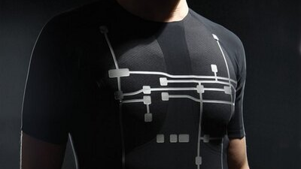
Second Part (Wearable Smart System)

Slide 46
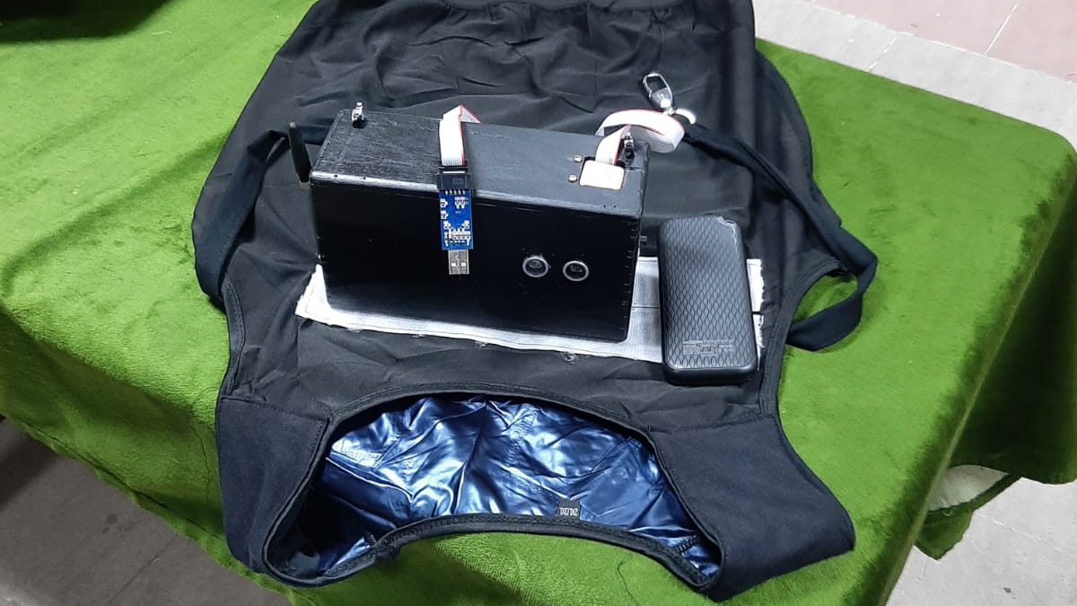
What is Wearable Smart System…?
Wearable smart system to help visually impaired persons (VIPs) ,walk by themselves through the streets, navigate in public places, and seek assistance.

Slide 47

Wearable Smart System
Components
Project plan
Block Diagram

Slide 48
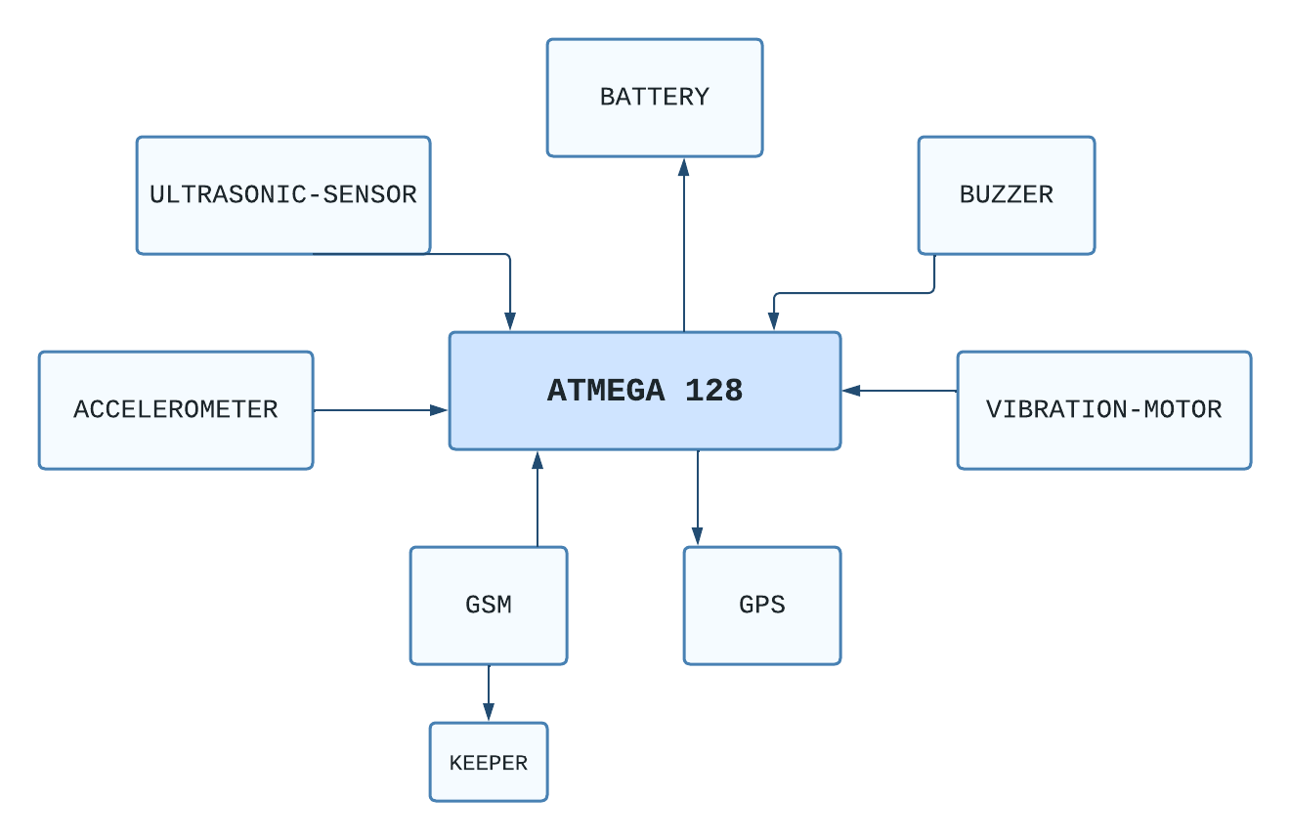
Block Diagram

Slide 49

Components

Slide 50
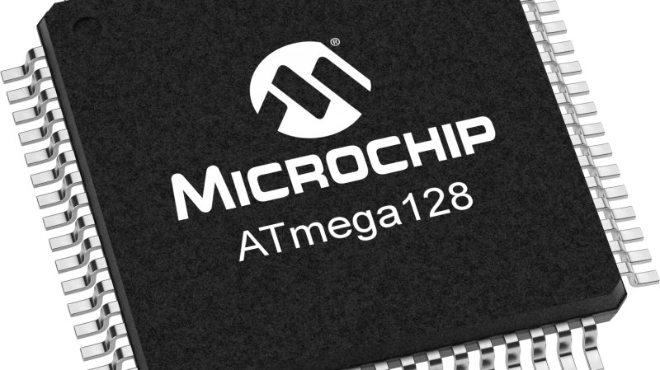
Controller
ATmega128 Kit
Features :
Speed 16MHz
64-pin
I/O 53
Flash memory 128K
EEprom 4k
Ram 4k
RISC architecture
Communications protocols like SPI, I2C, and 2-USRAT

Slide 51
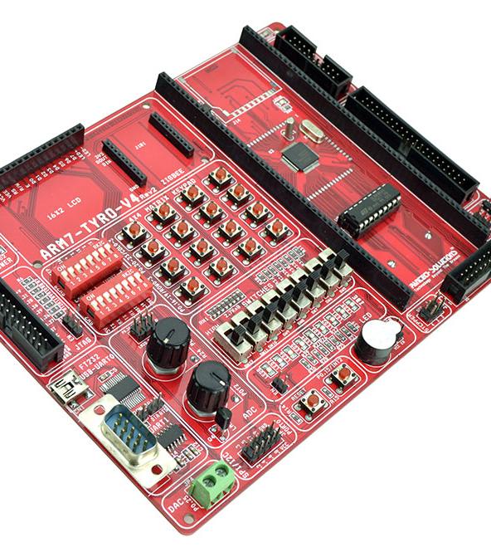
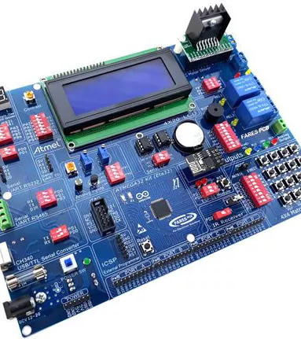
AVR VS Arm

Slide 52
AVR VS Arm
Arm | AVR
Has bus width of 32 bit and also available in 64 bit. | Has bus width of 8 bit or 32 bit.
It uses SPI,CAN,Ethernet,I2S. DSP,SAI,UART,USART. | It uses ART,USART,SPI,I2C.
It speed is 1 clock per instruction cycle. | It speed is 1 clock per instruction cycle.
It uses Flash, SRAM, EEPROM memory. | It uses Flash, SRAM, EEPROM memory.
It provide high speed operation | It is cheap and effective

Slide 53
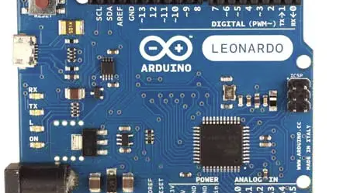
Why AVR, not Arduino …?
AVR is a single chip, and would require a breadboard
Arduino is a combination of both AVR (Atmega chip ) and breadboard.
But …
Arduinos are intended for experimentation and learning.
This sort of setup is unreliable, and not suitable for industrial operation.

Slide 54
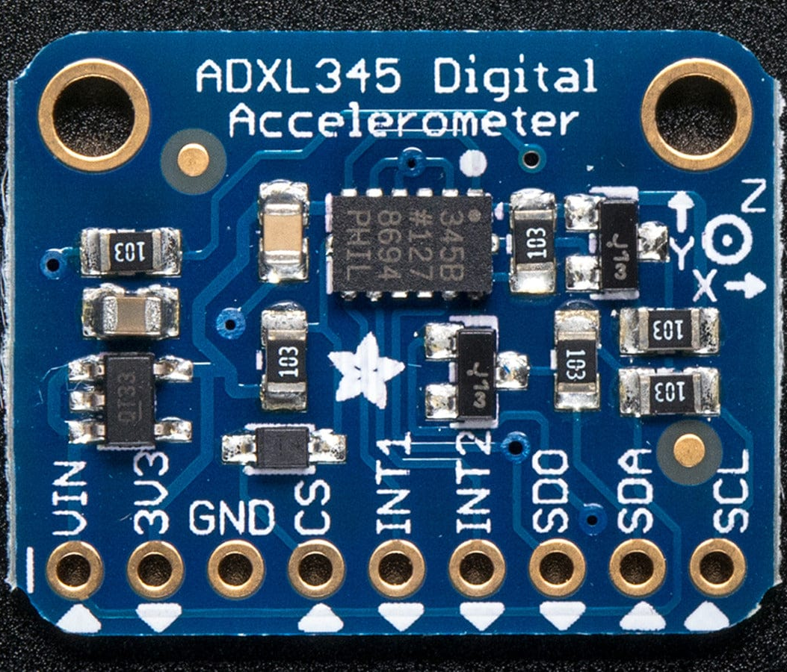
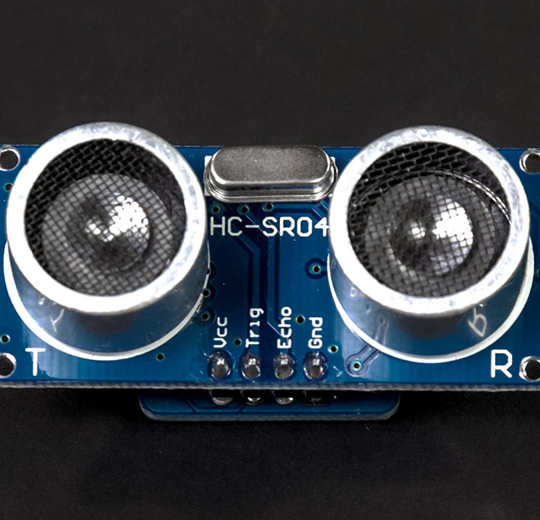
Sensors
Ultrasonic Sensor
Accelerometer

Slide 55
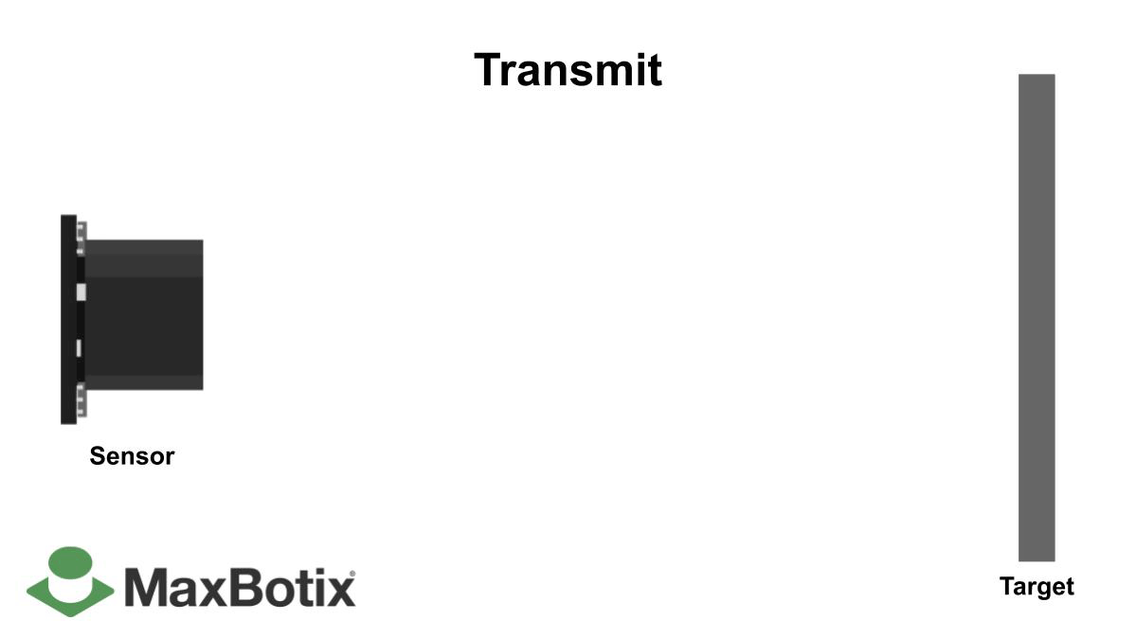
Measuring the destination of Ultrasonic Sensor :
Distance L = 1/2 × T × C
L: The distance
T: Time between the emission and reception
C: The speed of sound
The value is multiplied by 1/2 because T is the time for the go-and-return distance
The range of frequency of ultrasonic sensor between 25 kHz to 50 kHz
Distance: 2 cm – 400 cm.
Accuracy: 0.3cm.

Slide 56
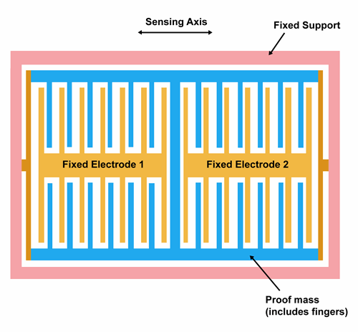
Accelerometer
device that measures the acceleration of motion of a structure.
The 3-axis digital accelerometer can measure acceleration in three directions and measurement ranges of ±2 g, ±4 g, ±8 g, and ±16 g to capture a wide range of accelerations.
1g= 9.8 m/s²
the maximum bandwidth of 3200Hz

Slide 57
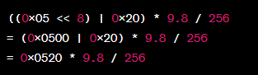
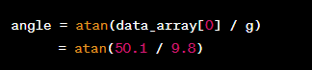
How Accelerometer work ..?
Accelerometer send 16 bit as 2 byte
Bit Shift
Shift first byte 8 position and add second byte → 16 bit
Multiply the binary number into gravity (9.8)Then divided it by 256
To transform from m/s² to angle
Then shift tan to the result number divided it by 9.8

Slide 58



Alarms
Buzzer
Vibration Motor
GSM&GPS

Slide 59


GPS
Global Positioning System
Using standard serial interface (UART).
NMEA Data.
NMEA is an acronym for the National Marine Electronics Association.
All NMEA messages start with the $ character, and each data field is separated by a comma.

Slide 60

NMEA Sentences
130113 - represents the time
37XX.XXXX,N - Latitude
07XXX.XXXX,E - Longitude
04 – number of satellites being tracked
3.97 – Horizontal dilution of position
404.9, M – Altitude, in meters above the sea level
45.7, M – Height of geoid (mean sea level) above WGS84 ellipsoid
*79 – the checksum data

Slide 61

NEO-6M GPS
It can track up to 22 satellites over 50 channels while consuming only 45mA of current .
4 satellites minimum number of satellites required by GPS to calculate an accurate position fix.
All GPS satellites broadcast on at least two carrier frequencies: L1, at 1575.42 MHz, and L2, at 1227.6 MHz (newer satellites also broadcast on L5 at 1176 MHz).

Slide 62

GSM
(Global System for Mobile Communications)
Using a standard serial interface (UART)
GSM use 2G networks to sending SMS messages, making phone calls.

Slide 63
SIM 900 GSM
Quad-band GSM that the module can operate on four different frequency bands: 850 MHz, 900 MHz, 1800 MHz, and 1900 MHz.
GSM-900 Bands and GSM-1800 Bands are used in most parts of the world: Europe, Middle East, Africa,Australia, Oceania (and most of Asia).
GSM-850 Bands and GSM-1900 Bands are used in Canada, the United States and many other countries in the Americas.

Slide 64
Command of sim 900
make call
"ATD+xxxxxxxx;\r\n"
Send SMS
"AT+CMGF=1\r\n" set the SMS text mode
"AT+CMGS=\"+201093812690\"\r\n" set the recipient's mobile number for sending an SMS.
Send word massage then send 26 by Uart to end message

Slide 65


Slide 66

Project plan

Slide 67

1st Scenario
When User face Obstcale Detected Turn , Buzzer and Vibration Motor On .

Slide 68

2nd Scenario
When User stumbles over or requires help , Turn buzzer on and make a phone call and send SMS to family, including current location.

Slide 69


3rd scenario
When a dangerous situation occurs, pressing a button will activate the GSM module to make a phone call and send an SMS with the current location.

Slide 70

Flow Chart

Slide 71

C Language
All drivers are coded using the C language.

Slide 72

Future Plan
We have met some problems that we could not solve at the present time but a future plan has been put in place to solve these problems and the biggest of these problems is dealing with potholes and downstairs.

Slide 73

1- Glove with very small distance sensors
Creating a glove with small distance sensors and incorporating slope calculation based on the user's height is an interesting concept.

Slide 74

2- Sensor in the headgear
placing a sensor in the headgear can be a viable solution. By measuring the orientation of the head, you can obtain more precise information about the user's tilt or inclination.

Slide 75


Slide 76
Done | C drivers have been created and combine all codes together in one main. Flashing the C Main code on whole project component together. Documentation. | April 2023
Done | Start Work on the practical final form of the project, test each part carefully and solve all problems. Documentation | May 2023
Done | Assemble all hardware parts to be delivered in the final form. Finished the Documentation. | June 2023

Slide 77




NTRA’s Sponsorship of Graduation Projects 16/1/2023
IEEE Egypt Section Chapter, AP03, MTT17 – Alexandria 5/3/2023
The 2nd International science and Engineering Innovations ISEIC' 2023 15/3/2023

Slide 78

Thank You

